Slide 1

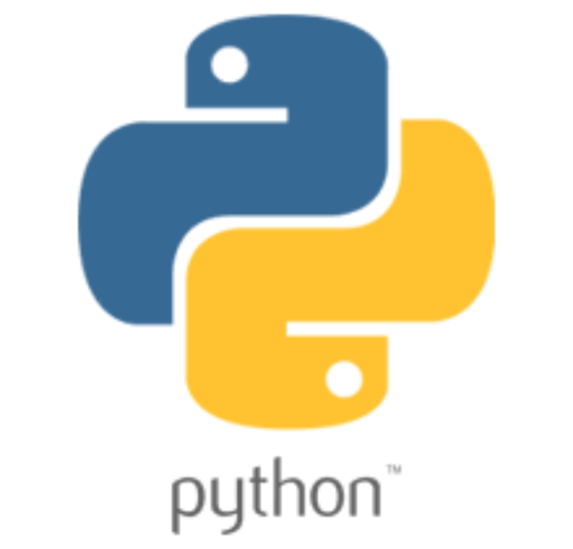

Why to use Alexa or SIRI when you can build your own MARCO
01
02
BUILD IT USING PYTHON LANGUAGE
03
PYTHON MINI PROJECT
04
DEPSTAR
4CSE2
VOICE ASSISTANT
Python is an interpreted high-level general-purpose programming language.
Designed By: Guido van Rossum
Developer: Python Software Foundation
First Appeared: 20 February 1991
HARSHIT TRIPATHI (D21DCS165)
RAJ PATEL (D21DCS161)

Slide 2
Modules used to build Marco:
01
02
Speech Recognition
DateTime
Wikipedia
Web Browser
Requests
PlaySound
gtts
OS
Wolframalpha
Pyjokes
Selenium
03
PYTHON MINI PROJECT
04
DEPSTAR
4CSE2
VOICE ASSISTANT
HARSHIT TRIPATHI (D21DCS165)
RAJ PATEL (D21DCS161)

Slide 3
Functionalities Marco can perform:
01
02
Greeting
Date and Time
Sending Mail
Playing Music
Google Search
Opening YouTube
Joke Recitation
Power Point Presentation
General Talks
Change Background
News Recitation
Locking and Shutting down system
03
PYTHON MINI PROJECT
04
DEPSTAR
4CSE2
VOICE ASSISTANT
HARSHIT TRIPATHI (D21DCS165)
RAJ PATEL (D21DCS161)

Slide 4
Implementation of Marco:
01
02
How about we meet our Marco now !
03
PYTHON MINI PROJECT
04
DEPSTAR
4CSE2
VOICE ASSISTANT
HARSHIT TRIPATHI (D21DCS165)
RAJ PATEL (D21DCS161)

Slide 5
Conclusion:
01
02
Please review our MARCO.
We also request you to ask us anything regarding our project.
03
PYTHON MINI PROJECT
DEPSTAR
4CSE2
04
VOICE ASSISTANT
HARSHIT TRIPATHI (D21DCS165)
RAJ PATEL (D21DCS161)

